Slide 1
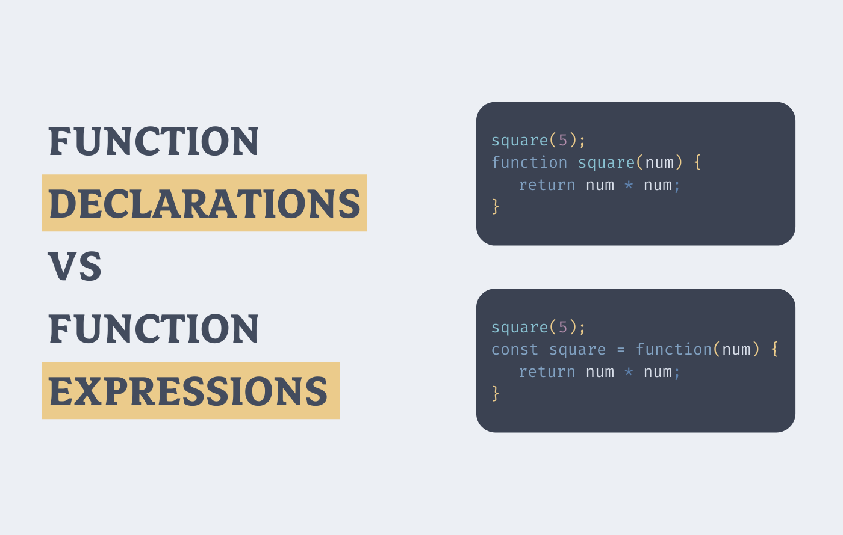

Slide 3
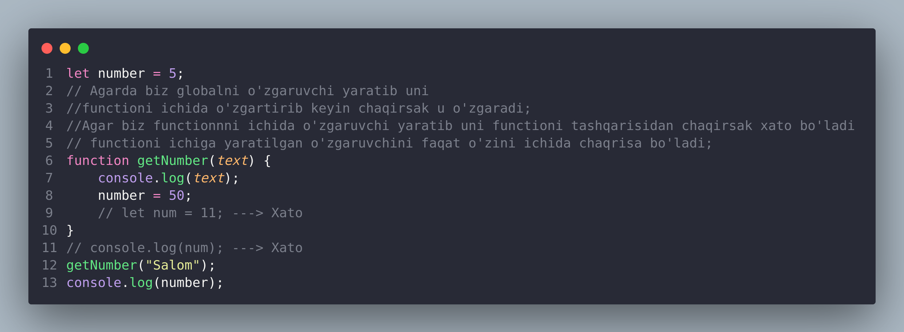

Slide 4
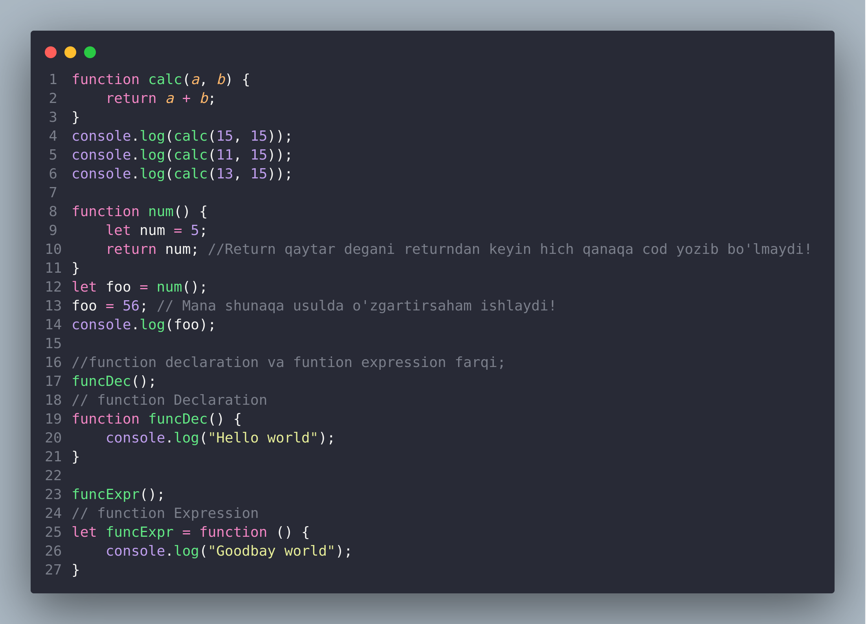

Slide 5
O’qli function (lineni function ruschasiga)
https://saidbek.dev/javascript-functions-javascript-funksiyalar-haqida-bilishingiz-kerak-bolgan-konikmalar#comments-list
Function haqida ma’lumot

Slide 6
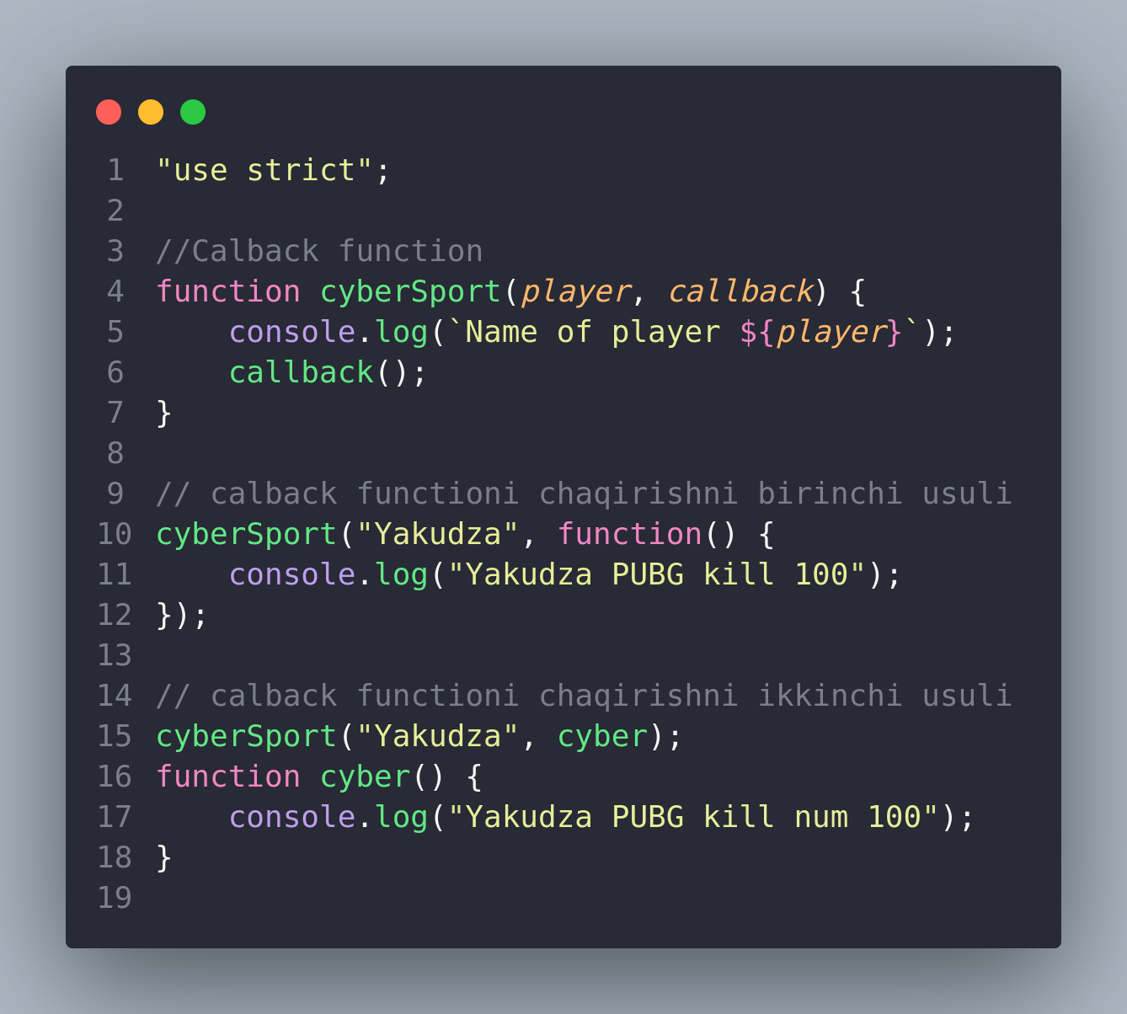
Function (calback)

